Slide 1
Higher National Certificate/Diploma in
Art & Design (Digital Design)
Unit 45 Web Design
Portfolio Web creating by
Dhiaa Abou Moghdeb

Slide 2
Introduction:
developers(HTML, CSS, JAVASCRIPT,,,etc) are responsible for the complete end-to-end coding of websites. They direct projects, develop web applications, code sites, and provide support to website users.
Going into the field of web design is very interesting, especially if it was through codes, I designed my portfolio using the HTML, CSS, jQuery programming languages, and as part to increased my experience in the field of design, this experience was very important to understand the details of the codes work and their results, which increased my confidence and added lot of skills that will help me design in the future, and that is why I chose to design a website about my CV to be the biggest proof of my ability and development in this field, The first I designed the web by xd method to make it easier for me and start using the codes.

Slide 3
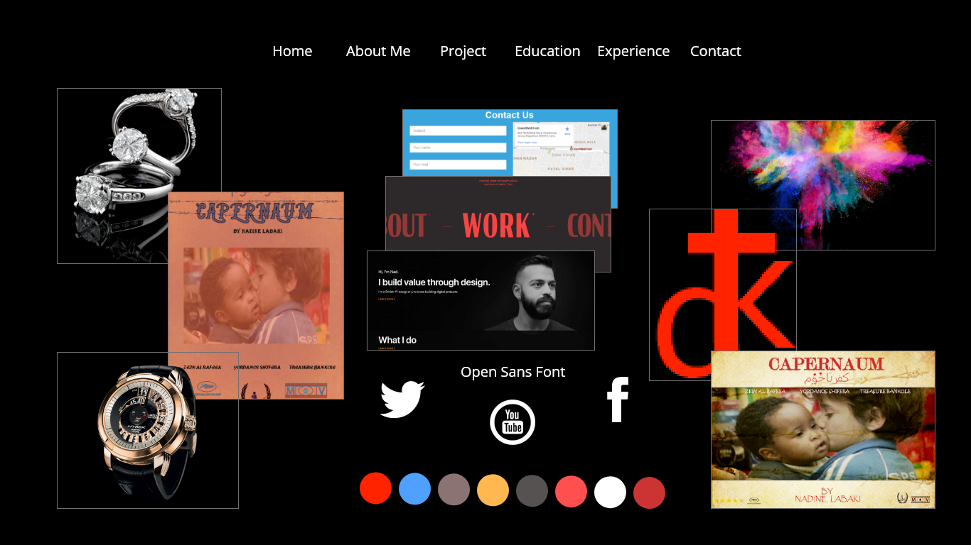
Moodboard
It is very important part of the design, must be formed the web idea through selecting the colors, font, the site shape, and other content. This is my mood board:

Slide 4
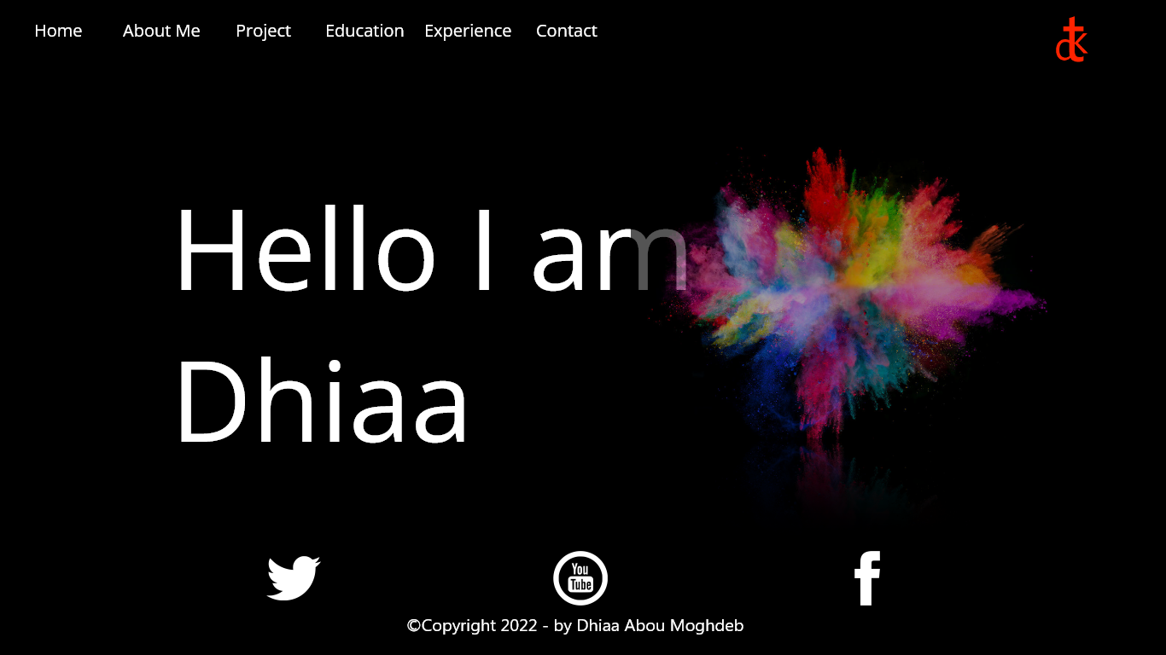
Through this experience, I was very keen to use everything we learned in classes and show the harmony between using the correct codes and design good web content

Slide 5
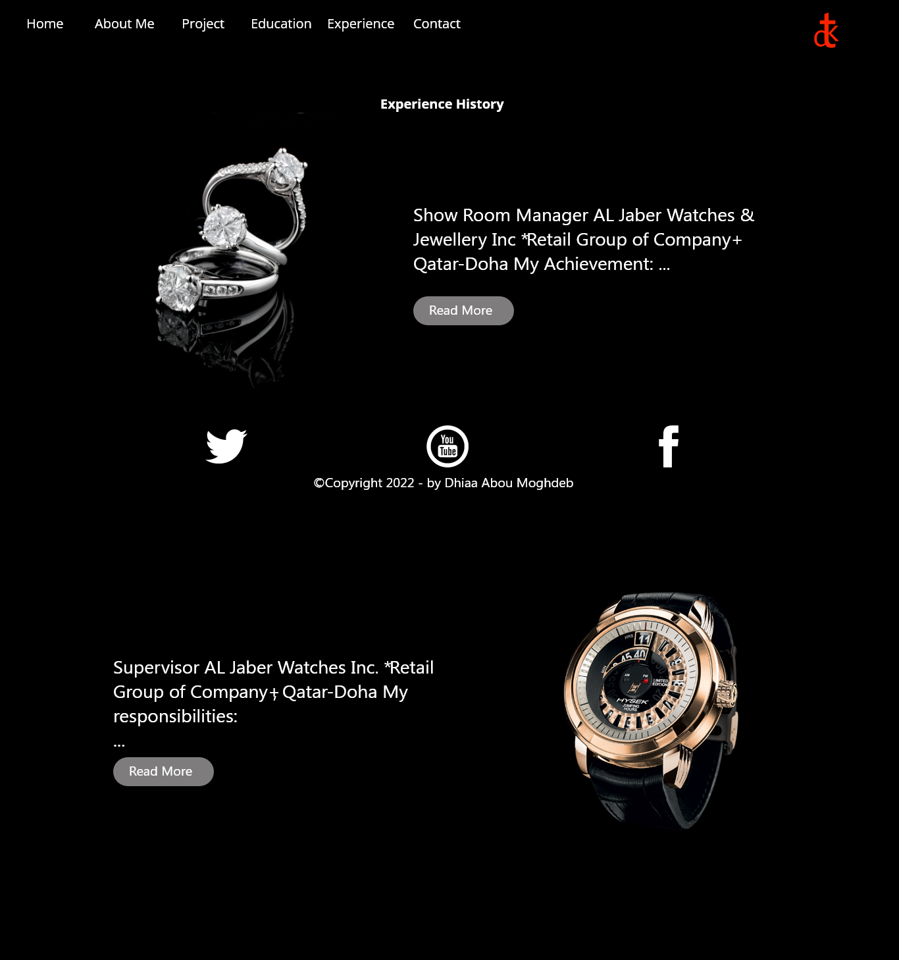
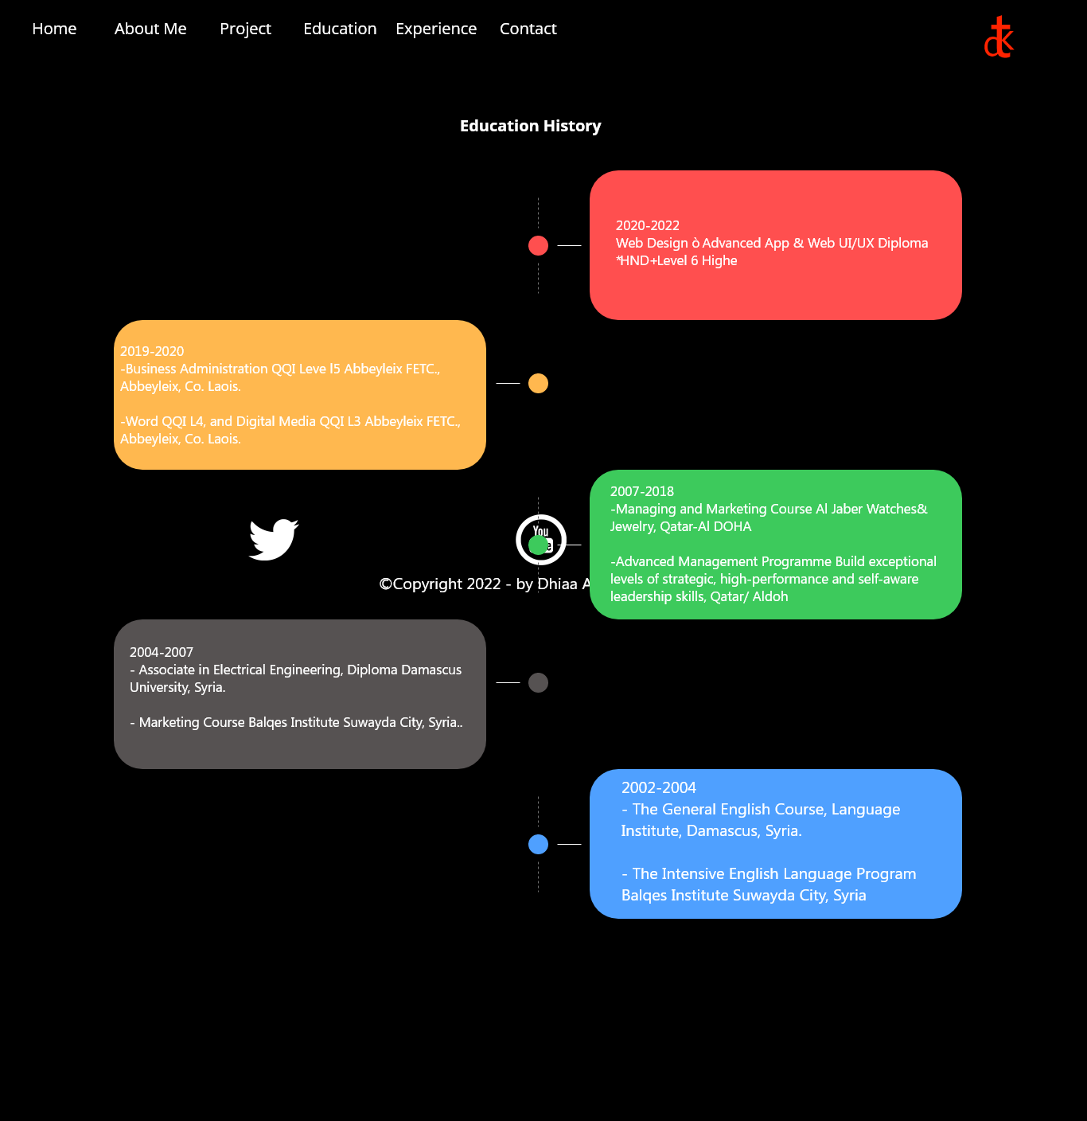
It is good to show all the details of education and experiences beautifully and simply, for that I used different codes.
Such as cards, layout, clear image and font.

Slide 6
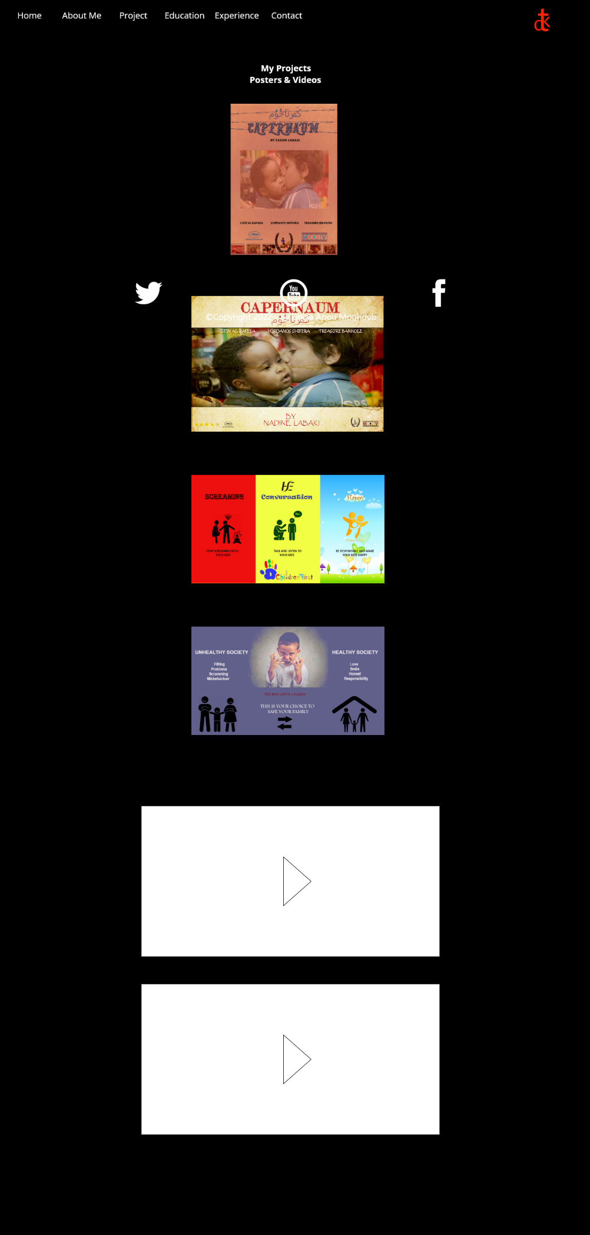
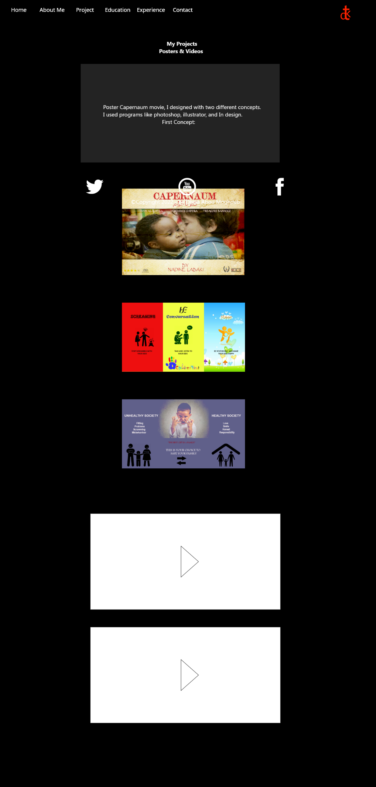
In addition to I used slideshow features on some pages.

Slide 7
Presented By,
Dhiaa Abou Moghdeb.
I appreciate your attention today, I’d like to thank you for your time.
The web link:
My Portfolio (ilikecake.ie)

